Slide 1
Design Human-Machine interface(HMI)

Slide 2
Outline
Design program to NX8048k050
Learn to nrf52840
User NX8048k050 with nrf52840
Testing

Slide 3
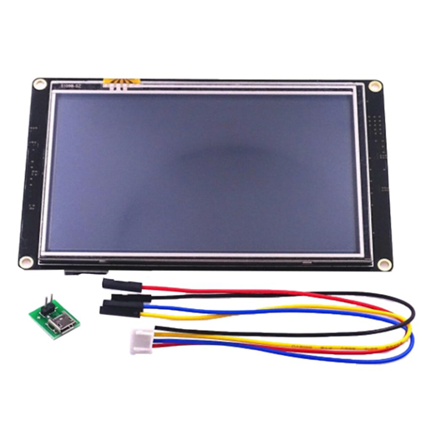
HMI = NX8048k050
Nextion includes a hardware part (a series of TFT boards) and a software part (the Nextion editor). The Nextion TFT board uses only one serial port to communicate.

Slide 4
Features
1. Available display size in 5.0” 2. RGB 65k Resistive/ Capacitive touchscreen 3. Up to 128MB for HMI project 4. +5V

Slide 5
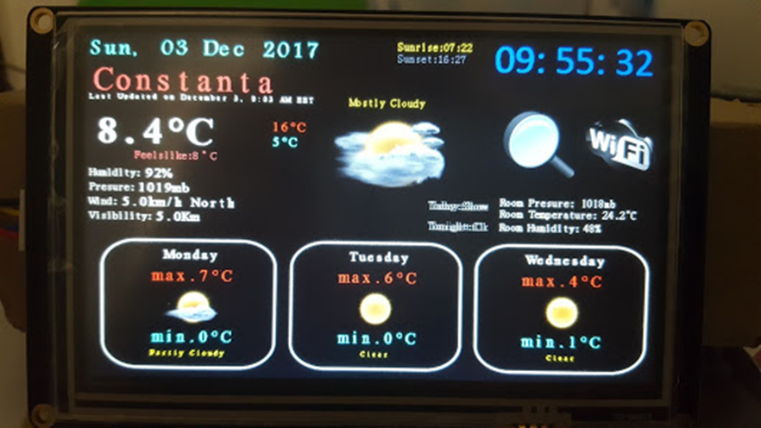
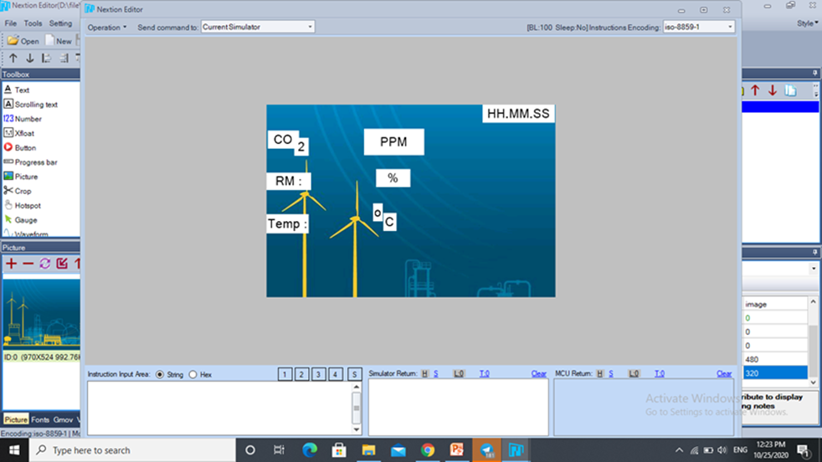
program design

Slide 6
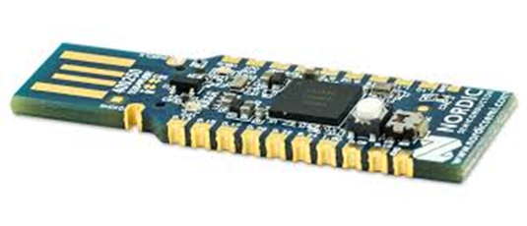


Slide 7
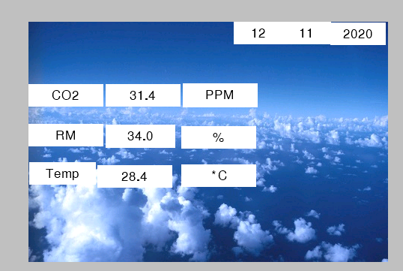

Slide 8


Slide 9
1.convert file Nextion to SD card 2.convert file SD card to HMI
Rule :

Slide 10
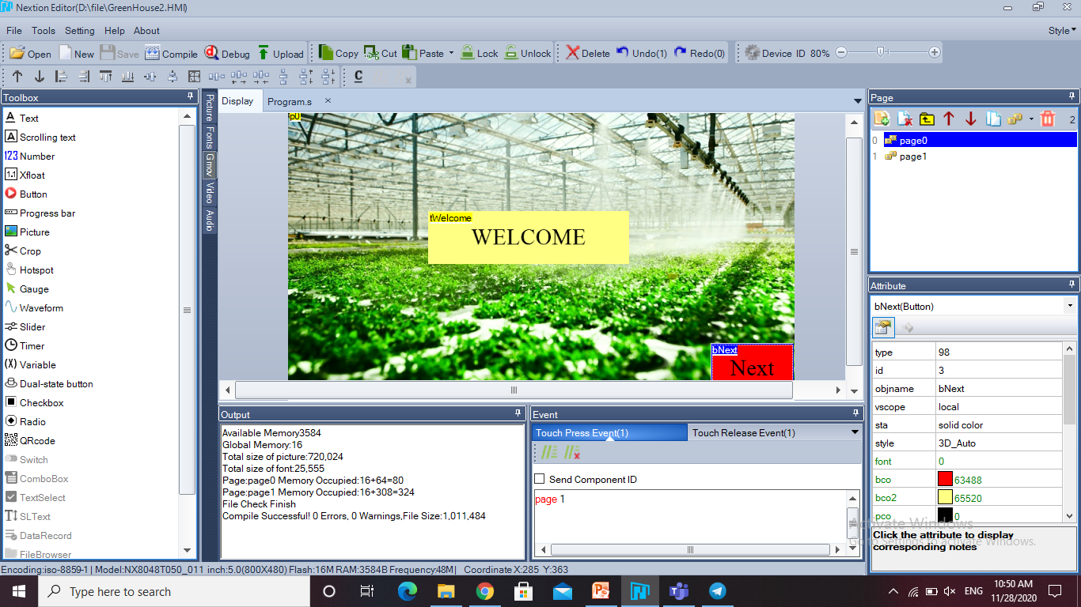
1
3
2

Slide 11
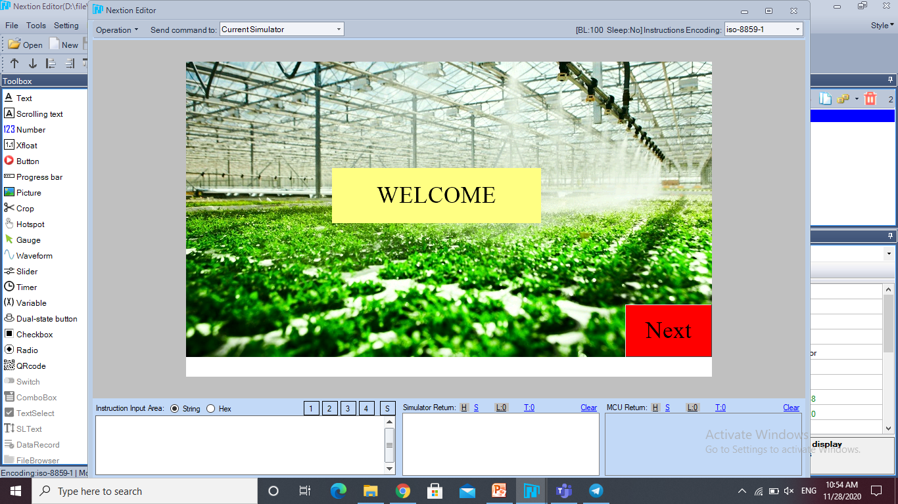
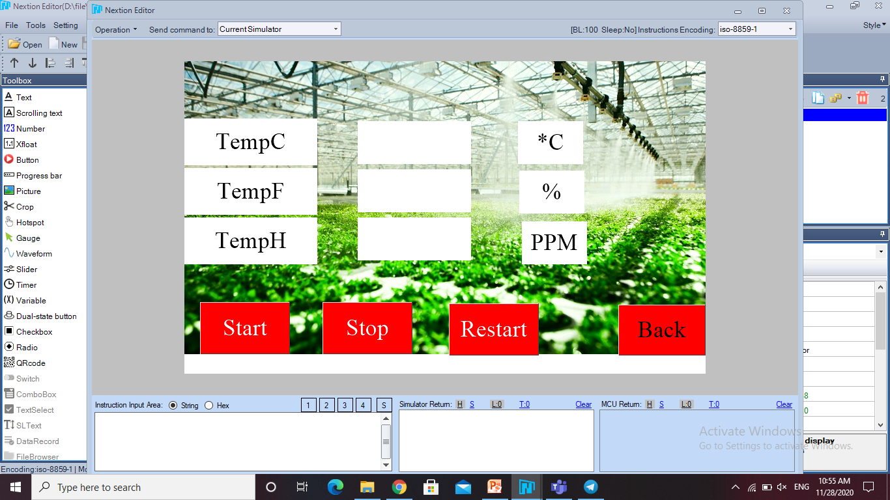
1
2

Slide 12
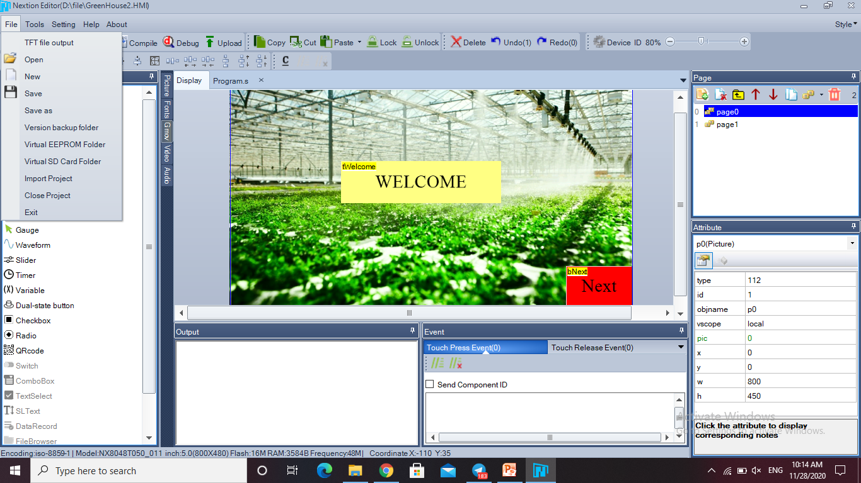

Slide 13
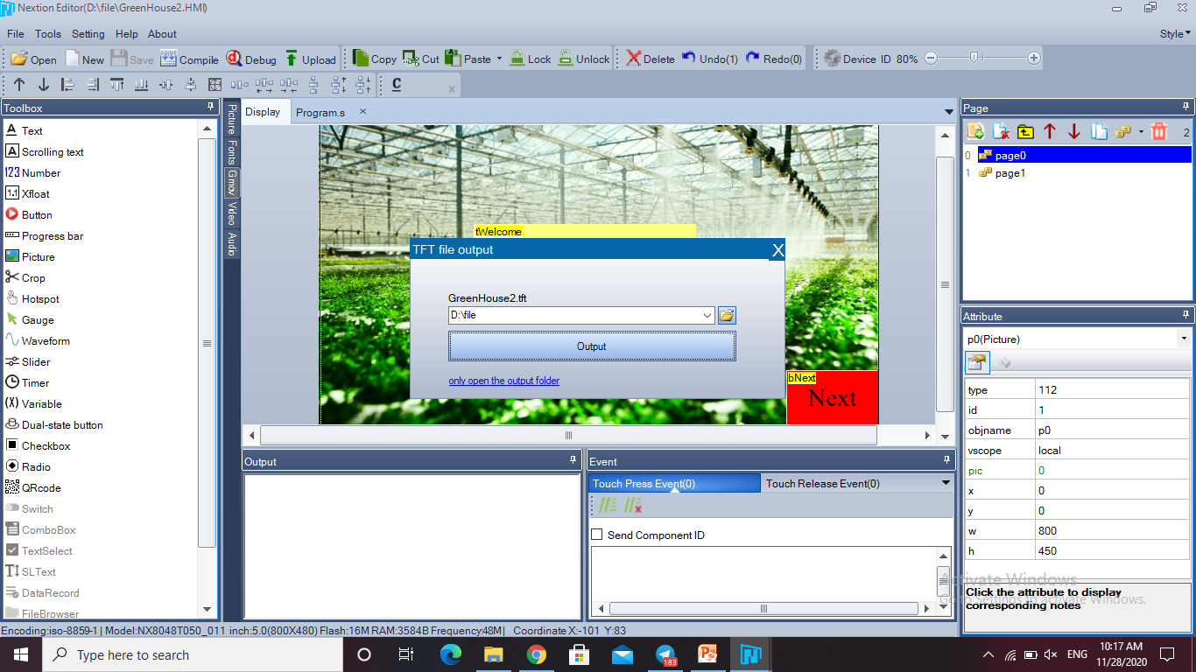
1
2

Slide 14
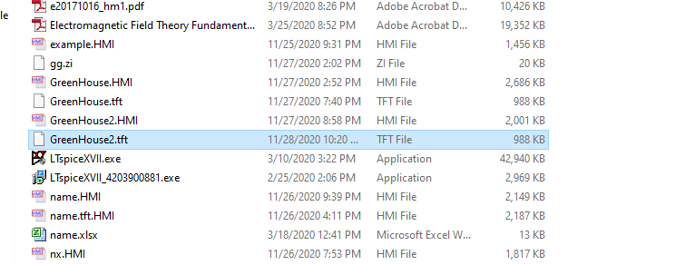
Example.HMI
Example.tft

Slide 15
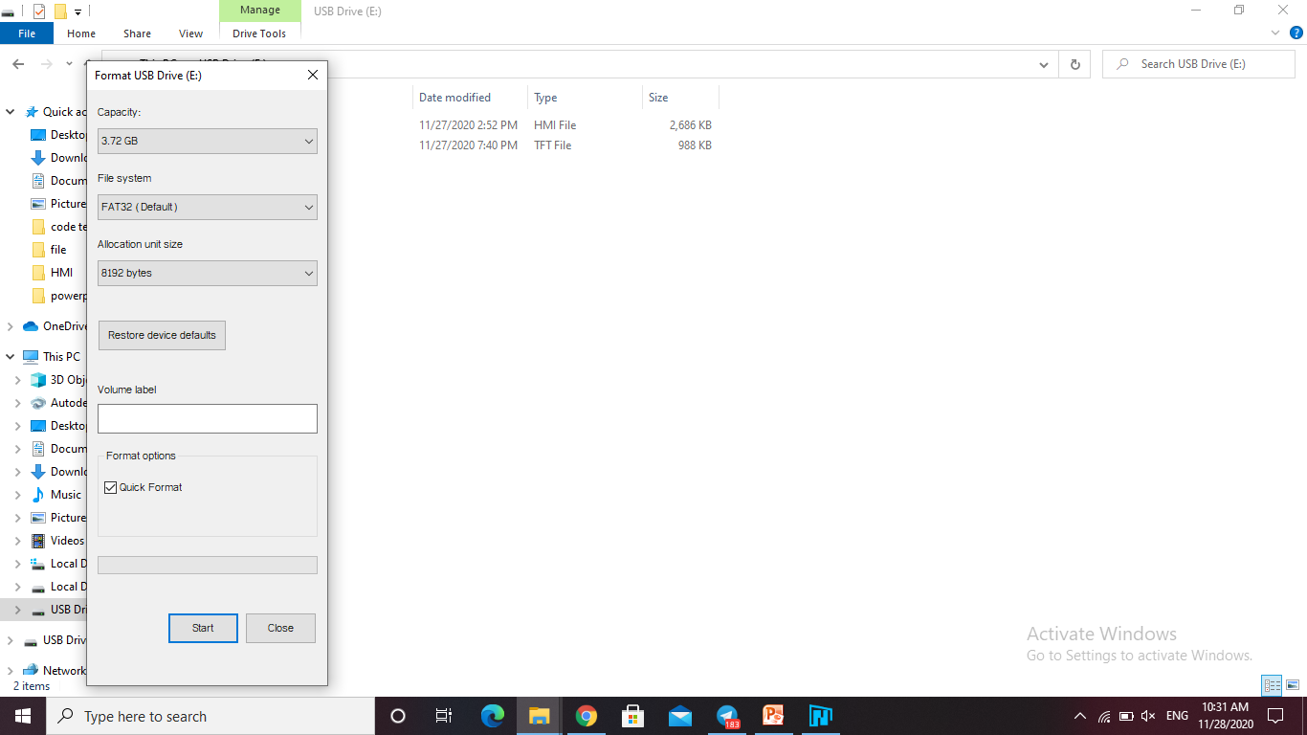
FAT32
8192 BYTES

Slide 16
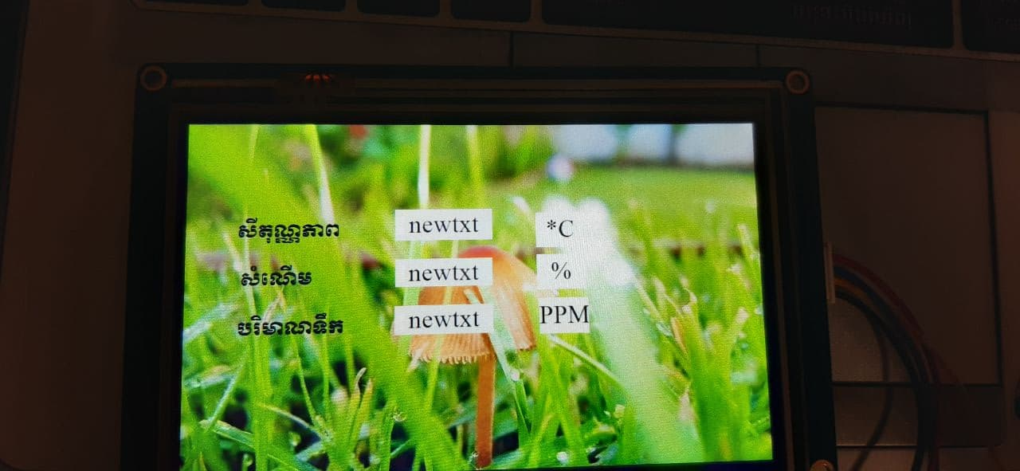

Slide 17
